Slide 1


The Friulian community in Belgium: an overview on the current linguistic context
Mikka Petris, Valentina De Iacovo and Antonio Romano
LFSAG - Phonetics Laboratory
Università degli Studi di Torino (Italy)
CLARC, Rijeka 24-26 June 2021

Slide 2
Introduction
Various linguistic studies on Italian migratory contexts (De Mauro 1963, Vedovelli 2011)
Lacking of sociophonetic studies based on speech data, also for heritage speakers and new generation (cf. Avesani et al 2015, Celata et al. 2010, etc… )
SEIM (oral archive, descriptive approach)
Interview-based spontaneous speech
Australia, Belgium…
CLARC, Rijeka 24-26 June 2021

Slide 3
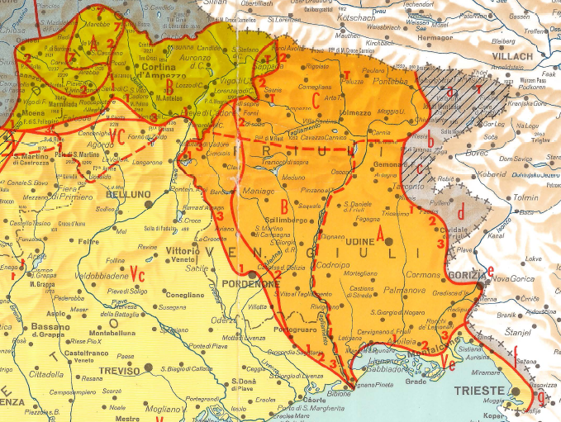
Friulian – historical, geographical and sociolinguistic overview
Friulian:
language of the Rhaeto-Romance group spoken in Friuli-Venezia Giulia (FVG), north-east of Italy
Three main dialectal subdivisions: middle-eastern; carnic and western (Francescato, 1966; Frau, 1984; Roseano, 2015: 162)
Nowadays is facing a slow but constant regression (Picco, 2001; Arlef, 2015), despite this the communities living abroad usually maintain a strong bond with the language of the origins (Francescato, 1974: 65).
Cividale
Castions
CLARC, Rijeka 24-26 June 2021

Slide 4
Emigration in Belgium
Protocol n. 365, 23 June 1946 (Belgium and Italy);
  50.000 Italian miners (max 35 years);
  2.000 people per week;
Fogolârs Furlans:
  Friulian emigrants’ associations;
  Spread all over the world;
  Friulian-speaking environments;
Fogolârs Furlans in Belgium:
  Liège → 1973
  Limburg → 1979
  Bruxelles → 1974-2014, 2016-ongoing
CLARC, Rijeka 24-26 June 2021

Slide 5
“a strong sense of ethnicity or of local identity often creates and maintains localized cultural and linguistic norms and value systems that are presented and perceived as sharply opposed to the mainstream values of outsiders” (Milroy & Milroy, 1992:6)
Language transmission influenced by the social status of the family and the community
Spatial distribution of the speakers (Krefeld 2002) influence cohesion within the community
  Liège → cohesive environment; diffusion of online magazines concerning Friulian culture; multilingual communication; strong bond with FVG (annual journey to the twin city in Friuli)
  Brussels → strong multilingual environment, center of “high” emigration (Vanvolsem, 2003), strongly heterogeneous participation, multilingual communication
  Interest of the speakers in maintaining certain language is generally compared to its economic power within certain communities (Jasparet & Kroon, 1991)
CLARC, Rijeka 24-26 June 2021

Slide 6
Oral corpus of semi-spontaneous interviews in Friulian
  Speakers of different generations
  Emigrant workers
  Friulian speakers born in Belgium
General analysis of 7 samples;
Intergenerational comparison between three groups
  1° group from Liège (father and daughter),
  2° group from Brussels (father and son),
  3° group from Brussels (speakers with no direct relationship).
  Focus on language contact phenomena and code-switching patterns;
  “the direction of switching is not relevant in terms of social meaning or function […] because it depends on the preferred code: we expect that speakers using the dialect more frequently will switch to Italian for contrasting effects and vice versa” (Giacalone Ramat, 1995: 52);
CLARC, Rijeka 24-26 June 2021

Slide 7
Liège
[1] Dopo a àn comincât a vegni <pl> polonês spagnoi an d’è di duti li rasis <pb> ma l’ere simpri par lavôr di mina <pl> o sennò la carriera
(and then started to come polish and Spanish people here you can find all kinds of origins but they all came for working in mines or in quarries)
[2] I sin stâs dapardut <pb> masim ades cal è il <pl> mercato di di nadâl
(we went everywhere especially now for Christmas markets)
SB → 78; native speaker: Friulian/Italian; education: Italy, Belgium; retired lathe machine worker; 65th year in Liège
[1] HLE: French + Friulian;
[2] Intrasentential CS
BB → 47; native speaker: French/Friulian; education: Belgium; accountant; born in Liège
[3] I ài lavorât par una dita par vincj aign ehm ca fai ehm ce môt ca si dis? ehm il ehm la publicitât nei giornalini
(I worked 20 years for a company that makes what’s the word? The advertisement in the newspaper)
[4] Alora ehm a si parla di una ricetta o l’altra ??? come in Belg\ come in Italia <inspirazione> alora uchì i vares da sentimi pui belga ma <pb> il fatto è che <pb> visto che i parli di […]
(so we speak of one recipe or another one like in Belg\ like in Italy so here I should feel more Belgian but the point is that since I speak of […]
[3] Lexical gap;
[4] Tag, lexical gap
CLARC, Rijeka 24-26 June 2021

Slide 8
Brussels
[5] e lì i vin fat la casa europea <inspirazione> ma B. a mi dîʃ chal ere cuintri <pb> a mi dîʃ sarà <pb> una cattedrale nel deserto
(and there we built the European House, but B told me that he was against this idea he told me: it will be a Cathedral in the desert)
[6] dal trentecinc gno pari al è stat riclamât <inspirazione> militâr <pl> sotto il regime fasista
(in the year 1935 my father was called back to the army under the fascist regime)
[7] CECA a disevin in che volte comunitât europee carbone e acciaio
(they used to call it ECSC: European Coal and Steel Community)
GC → 82; native speaker: Friulian/Italian; education: Italy; retired EU official; 54th year in Brussels
[5] Reported speech
[6] Emphasis
[7] Variable extension switched elements
LC → 46; native speaker: French/Italian; education: Belgium; language teacher; born in Brussels
[8] parcè che malgra<aa>do <pl> *l la cittadinanza ufficiale <pl> come chi disevi <pl> prime <pl> <nn>nel cûr <pl> i ài simpri <pl> cheste <pl> parte di italianitât
(because despite the official citizenship as I was saying first of all within my heart I always have this part of Italiannes)
[9] jo no cognoscevi nissun e quindi il cugino belga<aa>
(I did not know anyone so I was the Belgian cusin)
[8] Lexical gap
[9] Stable extension switched elements
CLARC, Rijeka 24-26 June 2021
Notes:
8

Slide 9
Brussels 2° group
[10] jo ce possio disi? <pb> puro prodotto del immigrazione <ridendo> nel senso che gno pari <ee>eh emigrato in Belgio nel milllenovecentonovantatre ehm scusami millenovecentoventitré
(what can I say? (I am) a pure product of the emigration I mean my father emigrated in Belgium in 1993 ehm sorry 1923)
[11] l’Italia era <ridendo + inspirazione> il nemico dal Belgio da la Francia eccetera dopo <inspirazione> tal cuarantacinc prima da la fin dal cuarantacinc lui al è tornât su
(Italy was the enemy of Belgium France and so on then in 1945 before its end he came back [in Belgium])
MA → 72; native speaker: Friulian/French; born in Belgium; education: Italy/Belgium; retired EU interpreter; 50th year in Brussels
[10] Emphasis
[11] Variable extension switched elements
DM → 58; native speaker: Friulian/French; born in France; education: France/Italy; EU official; 6th year in Brussels
[12] all'inizio ài fat operaio dopo i ài cambiât aziende e mi ài tacât a fâ {la carriera} di <mmh> <inspirazione> di di acuisitor fin a diventâ responsabil dagli acquisti<ii> <inspirazione> <ee>eh in grosse aziende come<ee> Zanussi e Jacuzzi […]
(in the beginning I was a workman then I changed company and I started a career of buyer and I became purchasing manager for big companies like Zanussi and Jacuzzi)
[12]Tag + lexical gap + stable extension switched elements
MB → 36; native speaker: Friulian/Italian; education: Italy/Ireland; EU official; 6th year in Brussels
[13] Dipent dipent <pl> a tent a stâ o poʃ dîʃ o a stoi pui di une setemane
(it depends it depends I tend to stay few days or more than a week)
[13] HLE: Italian + Friulian
CLARC, Rijeka 24-26 June 2021
Notes:
9

Slide 10
Final considerations
 | 1° GROUP |  | 2° GROUP |  | 3° GROUP
 | SB | BB | GC | LC | MA | DM | MB
Intersentential code switching | –/+ | –/+ | + | – | + | –/+ | –
Intrasentential code switching | + | + | + | + | + | + | –
Tag switching | + | + | + | –/+ | + | + | –
Hybrid lexical elements (Italian + Friulian) | + | + | – | + | + | –/+ | –/+
Hybrid lexical elements (French + Friulian) | + | – | – | – | – | – | –
Variable extension of the switched elements | – | – | + | – | + | – | –
Stable extension of the switched elements | + | + | – | + | – | + | –/+
Emphasis | – | – | + | – | + | – | –
Reported speech | – | – | + | – | – | –/+ | –
Lexical gap | + | + | + | + | + | + | –
Friulian → Italian switching | + | + | + | + | + | + | –/+
Friulian → French switching | – | – | –/+ | – | – | – | –
CLARC, Rijeka 24-26 June 2021

Slide 11
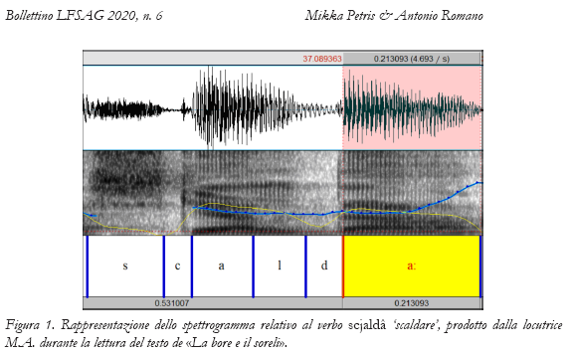
Speech corpus
Petris (2020), Petris & Romano (2020)
Miotti (2002), Finco (2006), Hajek & Cummins (2007), Roseano (2016).
CLARC, Rijeka 24-26 June 2021

Slide 12
Timing – stress- / syllable-based patterns
Stress-based → languages whose timing is dominated by stress patterns
Syllable-based → languages whose timing is dominated by syllabic patterns
Natural typology of languages emerging from the observation of:
different versification traditions;
variable ease of fitting in musical-rhythmic frames.
CLARC, Rijeka 24-26 June 2021

Slide 13

How to measure rhythm?
σ_{w} σ_{s} σ_{w} σ_{s} σ_{w}
C V V C C V C C C V C C V C
σ-dep.
I_{C}-I_{V}
VV
(P-center)
σ_{w} σ_{s} σ_{w} σ_{s} σ_{w}
D_{Ic} D_{Iv} D_{Ic} D_{Iv} D_{Ic} D_{Iv} D_{Ic} D_{Iv} D_{Ic}
P_{v} P_{v} P_{v} P_{v} P_{v}
CLARC, Rijeka 24-26 June 2021

Slide 14
Speech Rhythm Models and Rhythmic Metrics
Sources of variability in metrics estimate
O'Dell & Nieminen (1999); Barbosa (2006); Bertinetto & Bertini (2011)
Ramus et alii (1999); Grabe & Low (2002)
Phonological vs. phonetic classification of segmental units (Mairano & Romano, 2007a, 2008);
Sensitivity of metrics to segmentation choices made by different operators (Mairano & Romano, 2007b);
Different ways to compute metrics for segmental stretches (Romano & Mairano 2007b);
CCI metrics (Romano 2020).
CLARC, Rijeka 24-26 June 2021

Slide 15
A speech sample for testing rhythmic metrics
Romano (2016), Romano & De Iacovo (2020) - https://www.lfsag.unito.it/ark/trm_index.html
The North Wind and the Sun
The North Wind and the Sun were disputing which was the stronger, when a traveller came along wrapped in a warm cloak. They agreed that the one who first succeeded in making the traveller take his cloak off should be considered stronger than the other. Then the North Wind blew as hard as he could, but the more he blew, the more closely did the traveller fold his cloak around him; and at last the North Wind gave up the attempt. Then the Sun shone out warmly, and immediately the traveller took off his cloak. And so the North Wind was obliged to confess that the Sun was the stronger of the two.
Did you like the story? Do you want to hear it again?
Sjeverni vjetar i Sunce
Sjeverni ledeni vjetar i Sunce su se prepirali o svojoj snazi. Stoga odluče da onome od njih pripadne pobjeda koji svuče čovjeka putnika. Vjetar započe snažno puhati, a budući da je čovjek čvrsto držao odjeću, navali on još jače. Čovjek pak, još jače od studeni pritisnut, navuče na sebe još više odjeće, dok se vjetar ne umori i prepusti ga tada Suncu. Ono u početku zasija umjereno. Kad je čovjek skinuo suvišak odjeće, povisi ono još jače žegu dok se čovjek, u nemogućnosti da odoli sunčevoj toplini, ne svu če i ne pode na kupanje u rijeku tekućicu. Priča pokazuje da je često uspješnije uvjeravanje negoli nasilje.
Da li ti se svidijela ova priča? Da li želiš da je čuješ ponovo?
La bore e il soreli
Un dì la bore e il soreli a custionavin su cui dai doi al fos il pui fuart,
fin quant che a no han viodut a passà un cristian cun intor un mantel.
Alore a han decidut che il pui fuart al sarest stat chel dai doj ch’ai vares fat gjavà il mantel.
La bore par prime a ha tacat a soflà cun dute la so fuarce,
ma pui a soflave e pui chel om al strengeve il mantel
finchè la bore a no si è rindude.
Il soreli alore al ha tacat a scjaldà e cul cjalt chel om al ha scugnut gjavà il mantel.
Cussì la bore a ha scugnut ametti che il soreli al ere pui fuart di je.
Ti ese plasude la storie?
Atu voe chi ti la conti un’altre volte?
CLARC, Rijeka 24-26 June 2021

Slide 16
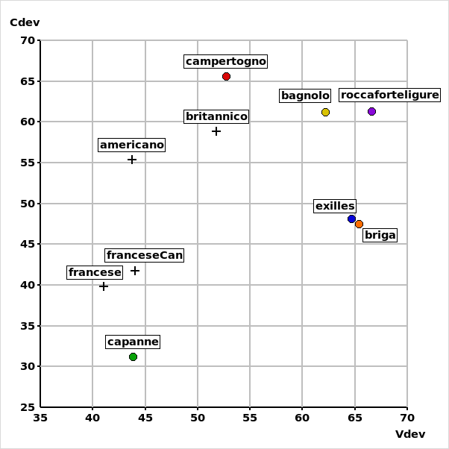
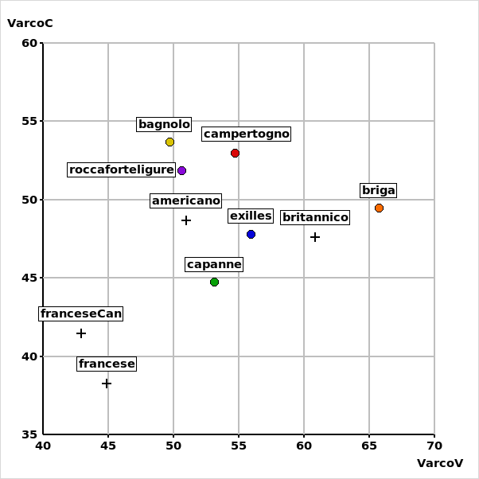
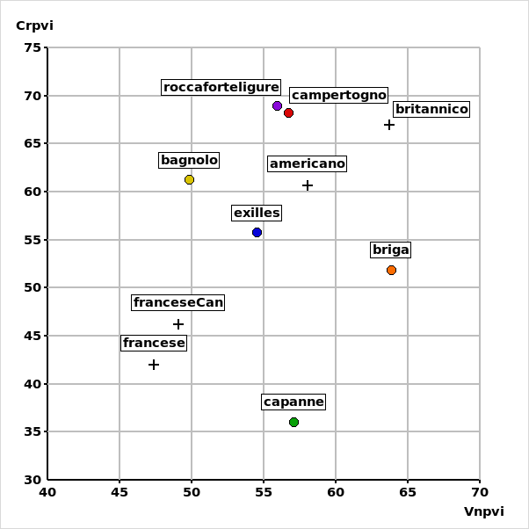
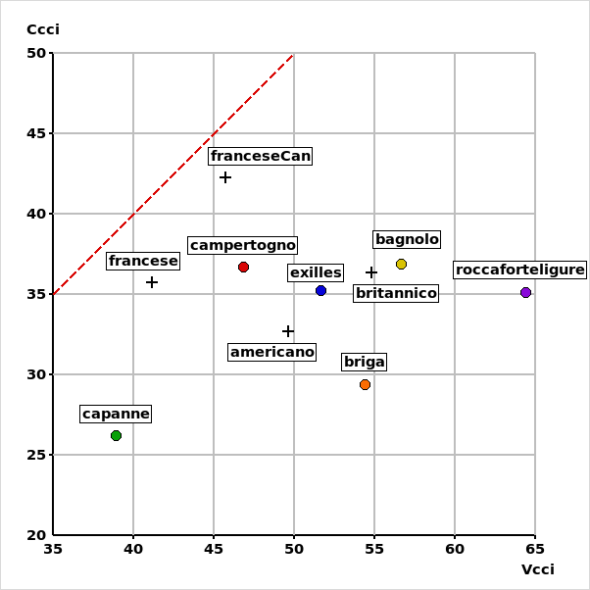
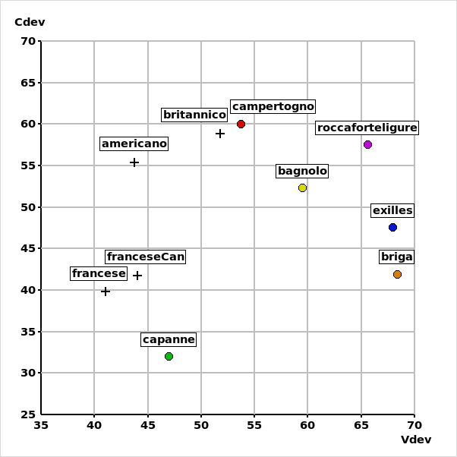
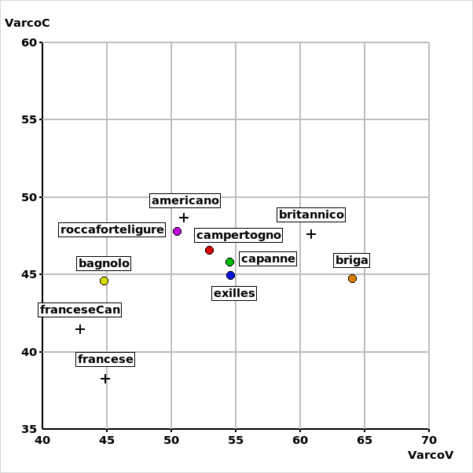
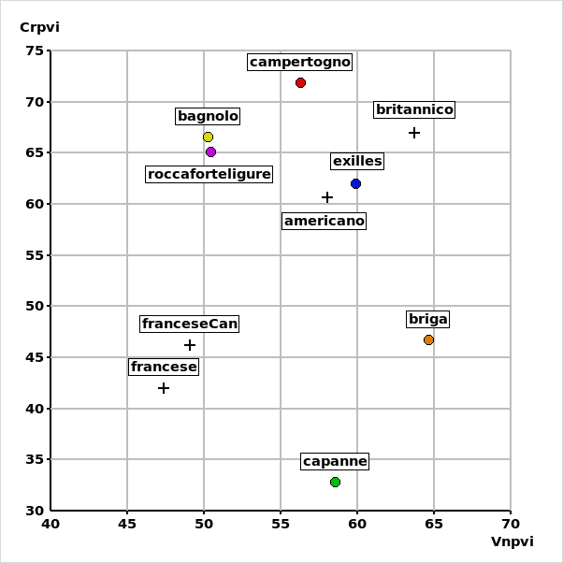
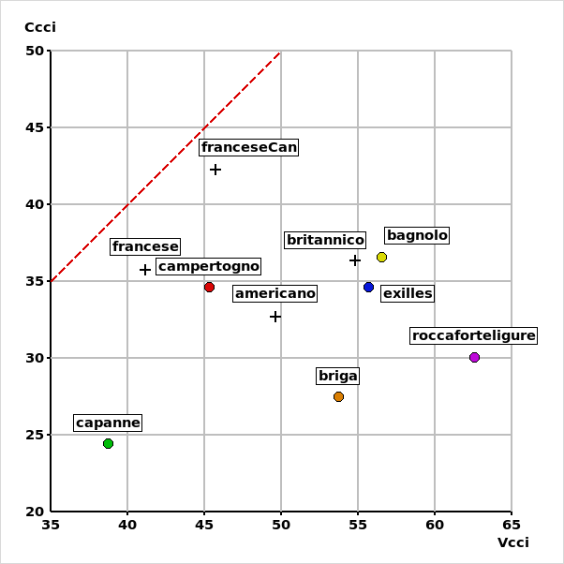
Comparing metrics: Correlatore
(Mairano & Romano, 2009)
https://www.lfsag.unito.it/correlatore/index.html
CLARC, Rijeka 24-26 June 2021

Slide 17
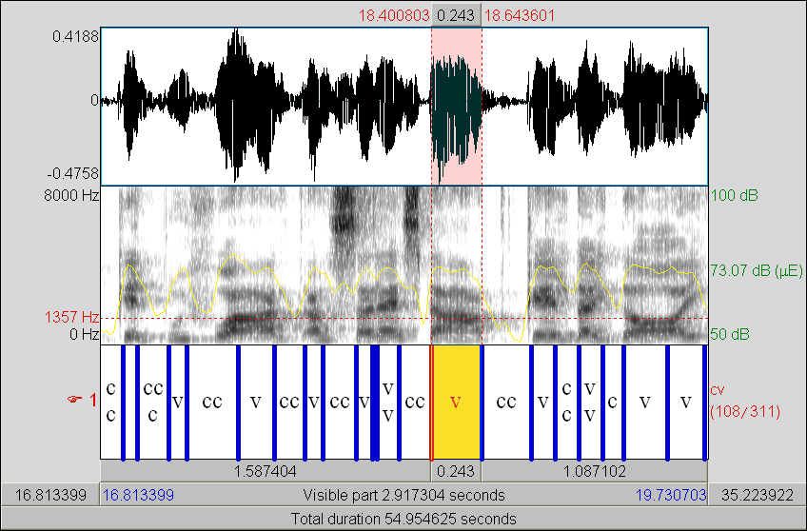
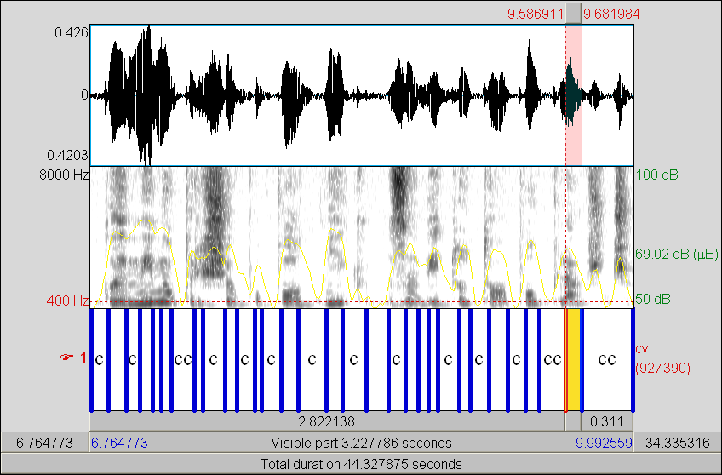
Friulian vs. Slovenian
itdia_ud_f_cividale_del_friuli
slovenian_slovenia_f_ljubljana
CLARC, Rijeka 24-26 June 2021

Slide 18
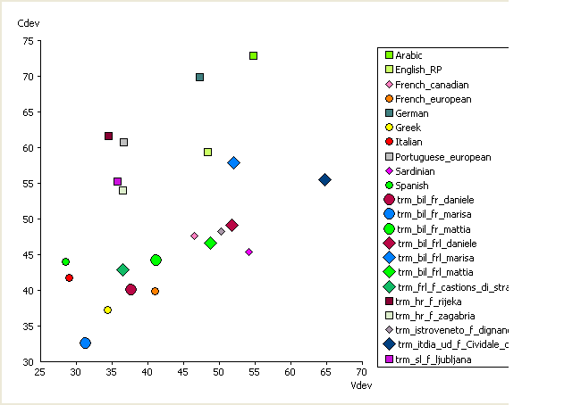
Rhythmic Metrics for Friulian and Fr-Frl bilingual speakers
Gamal (2006), Gut (2012), Romito & Tarasi (2012), Schmid & Dellwo (2013)
CLARC, Rijeka 24-26 June 2021

Slide 19
Conclusions
The data presented here represent some tendencies of the speakers taken into consideration and they should not be generalized to the whole communities;
It confirms studies on weak mutual interference between languages, but...
Speech rhythm for bilingual speakers need more accounts;
In order to confirm the statements outlined here, a larger amount of data is needed.
Hvala!
CLARC, Rijeka 24-26 June 2021

